Slide 1
Discover the role of Python in space exploration
Abhigya Verma Microsoft Learn Student Ambassador Alpha

Slide 2
Session 2: Install coding tools for Python development Learn about what coding is and install tools to help you code.
Abhigya Verma Microsoft Learn Student Ambassador Alpha

Slide 3
Learning objectives
How to install Visual Studio Code and about the benefits of this code editor
How to install extensions to enhance the Visual Studio Code experience
How to install Python and why it is such a popular programming language
How to run a basic Jupyter Notebook within Visual Studio Code

Slide 4
Prerequisites
A Windows, Mac, or Linux computer
Knowledge of how to download programs from the Internet

Slide 5
Understand the importance of Python in solving big data problems
A little bit about Python
Why Python?
Real world examples of Python at work
Jupyter Notebooks and Python

Slide 6
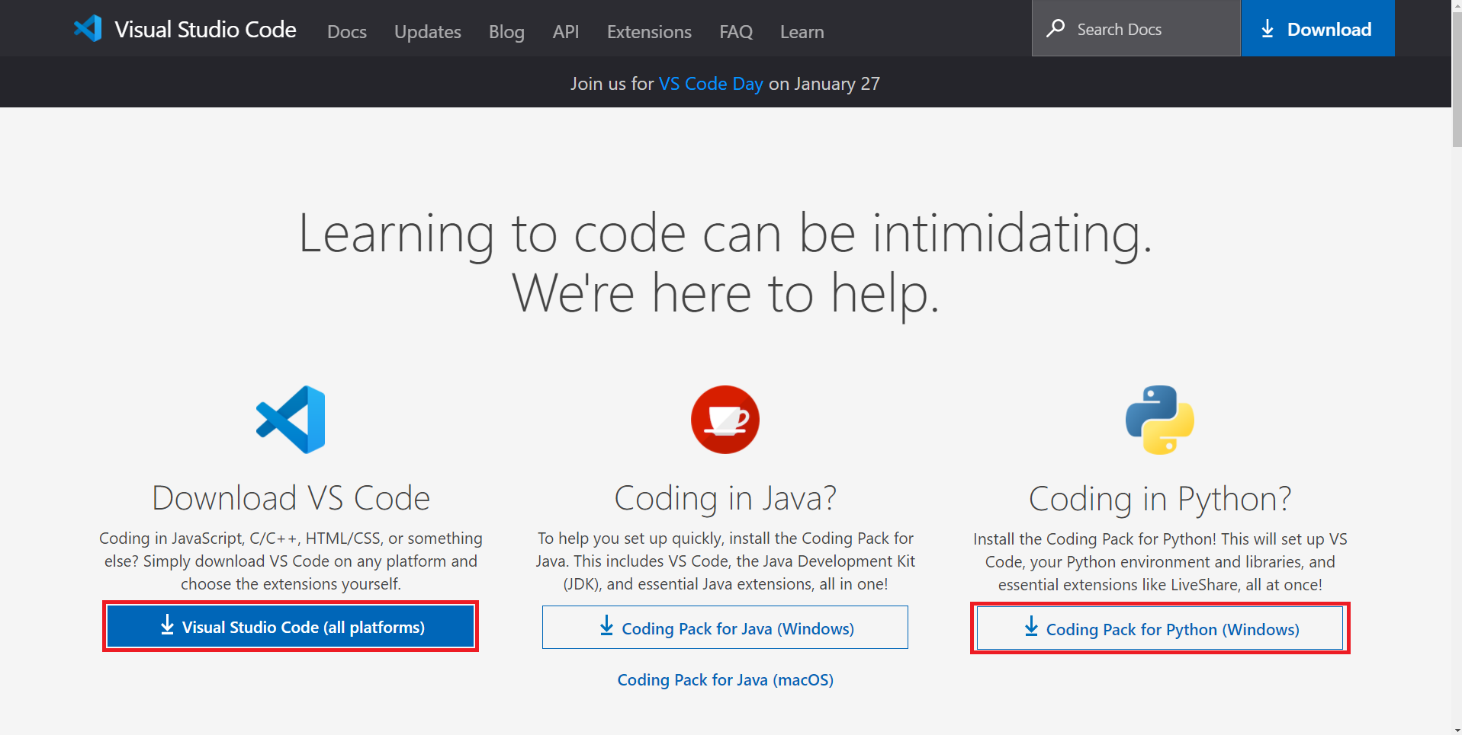
Install and configure Visual Studio Code for data exploration

Slide 7
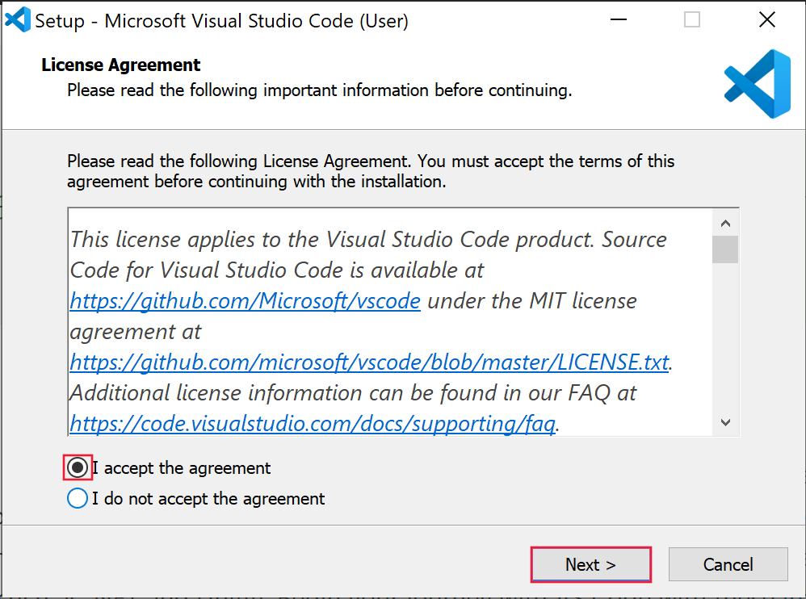
Install and configure Visual Studio Code for data exploration

Slide 8
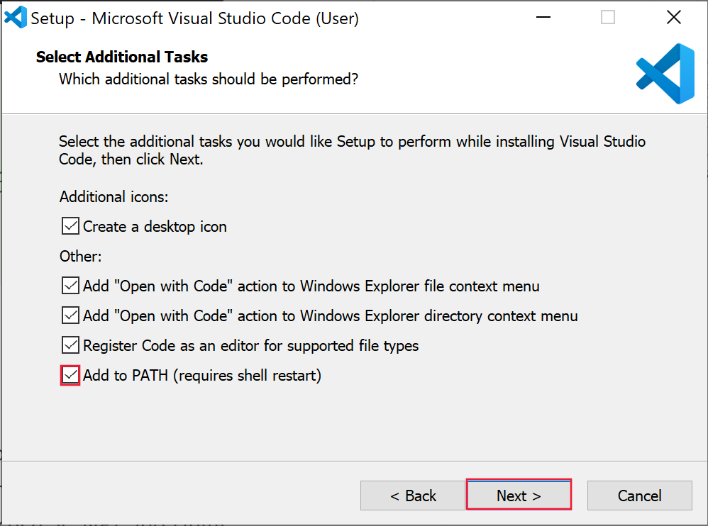
Install and configure Visual Studio Code for data exploration

Slide 9
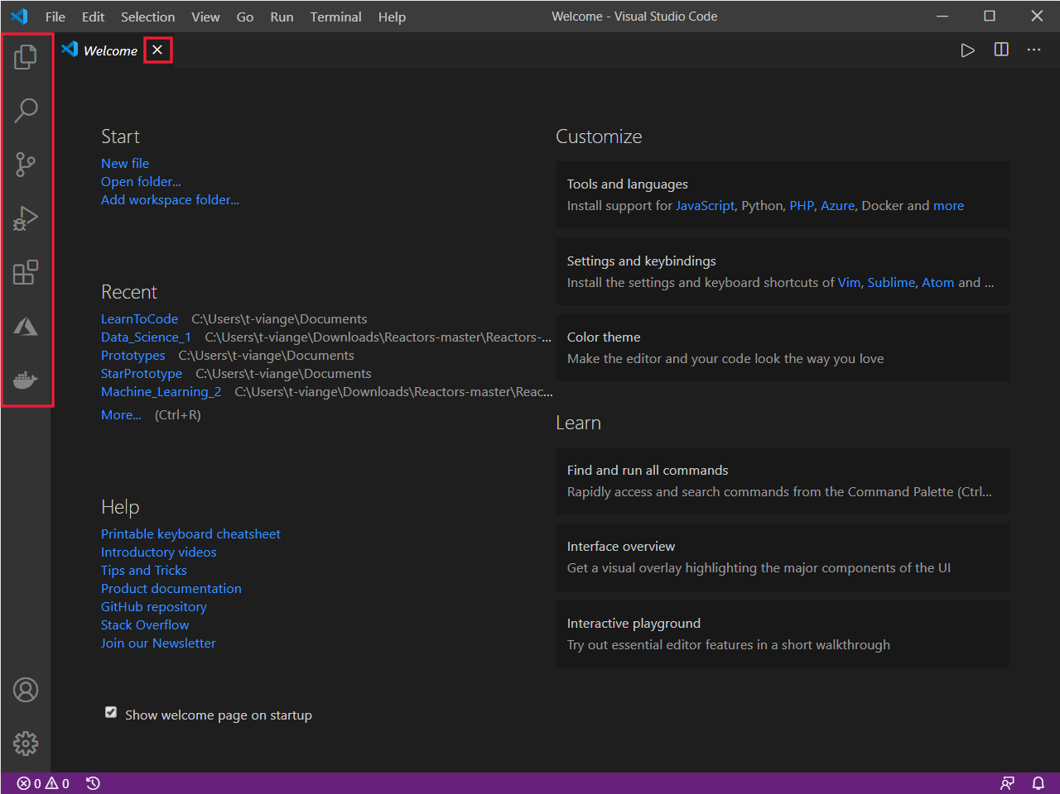
Configure Visual Studio Code

Slide 10
Run Visual Studio Code in your browser for data exploration
The benefit of GitHub Codespaces include:
Having your development environment linked to your GitHub account rather than a physical device
Tighter integration with GitHub for your projects
Visual Studio Code extensions available for customization
Projects with different development environments won't clash on your physical device

Slide 11
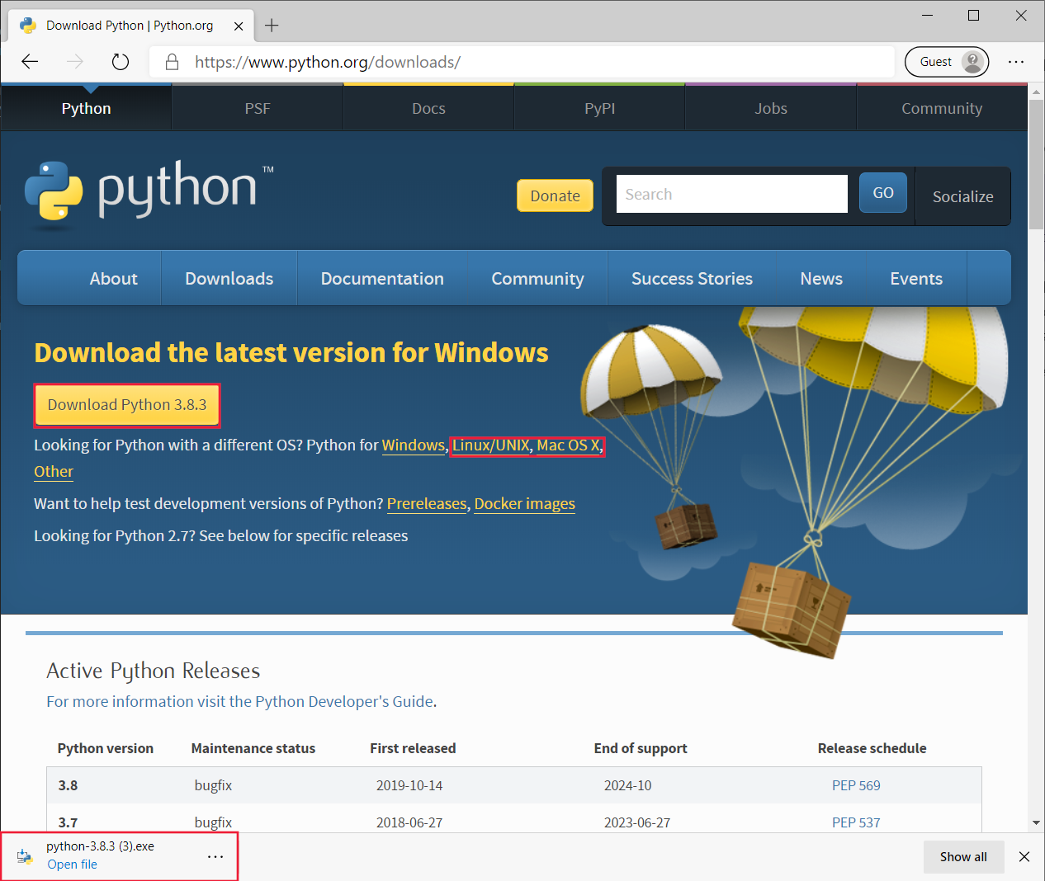
Install Python to use in Visual Studio Code for data exploration

Slide 12
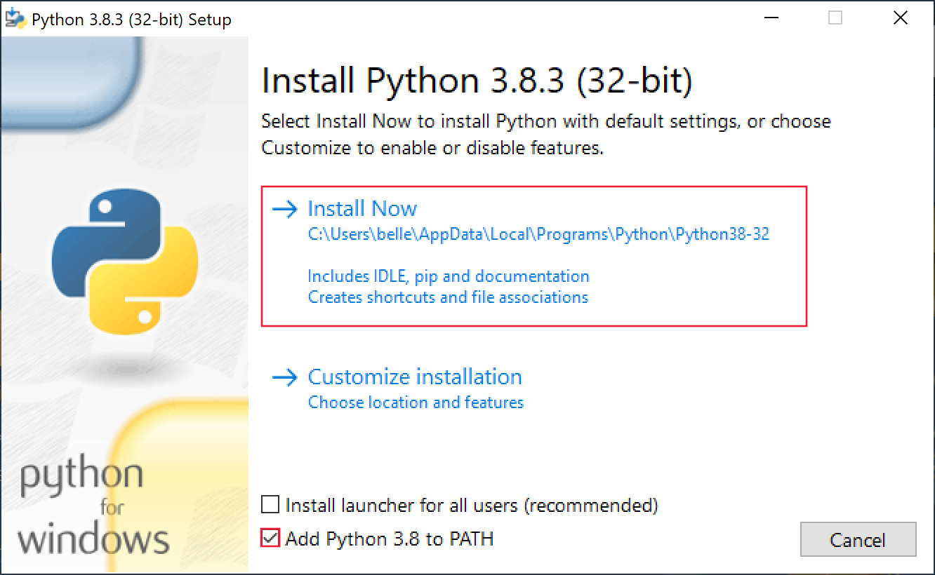
Install Python to use in Visual Studio Code for data exploration

Slide 13
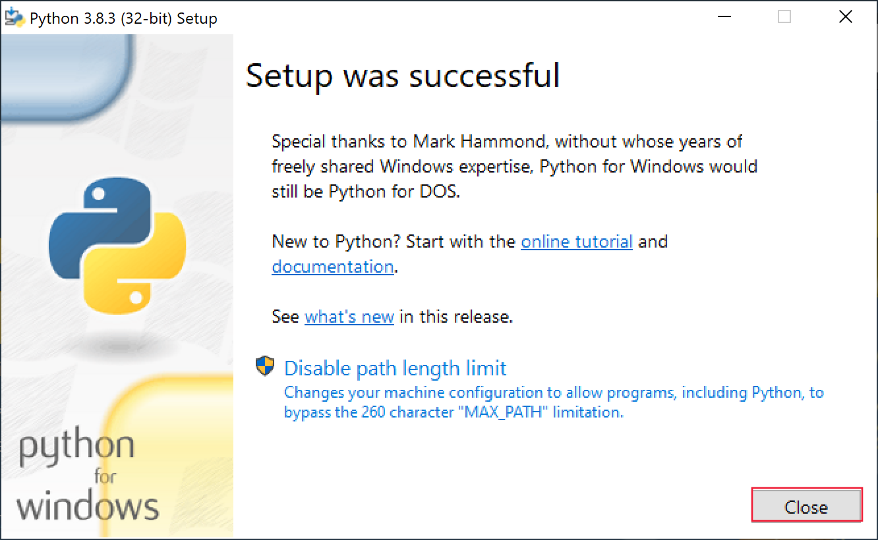
Install Python to use in Visual Studio Code for data exploration

Slide 14
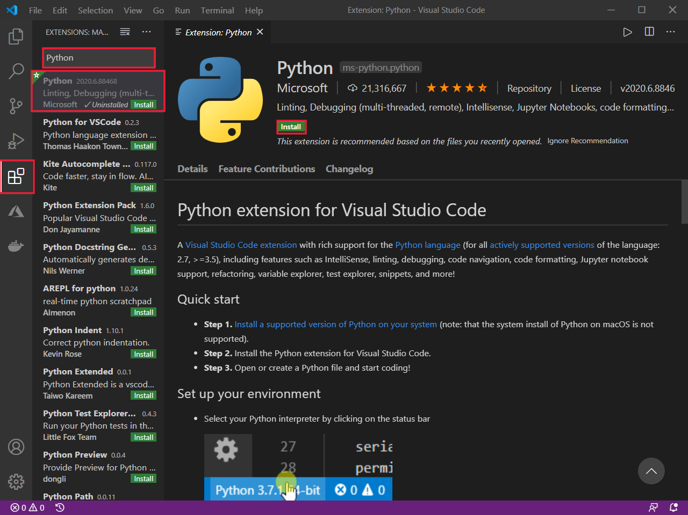
Install Visual Studio Code extensions needed for data exploration

Slide 15
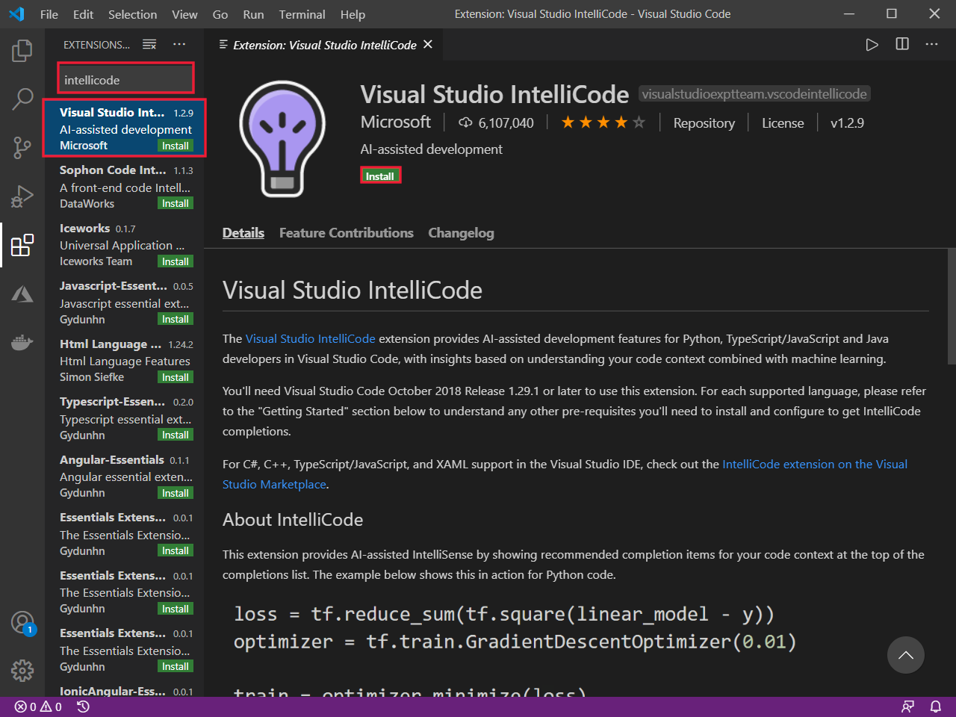
Install IntelliCode extension

Slide 16
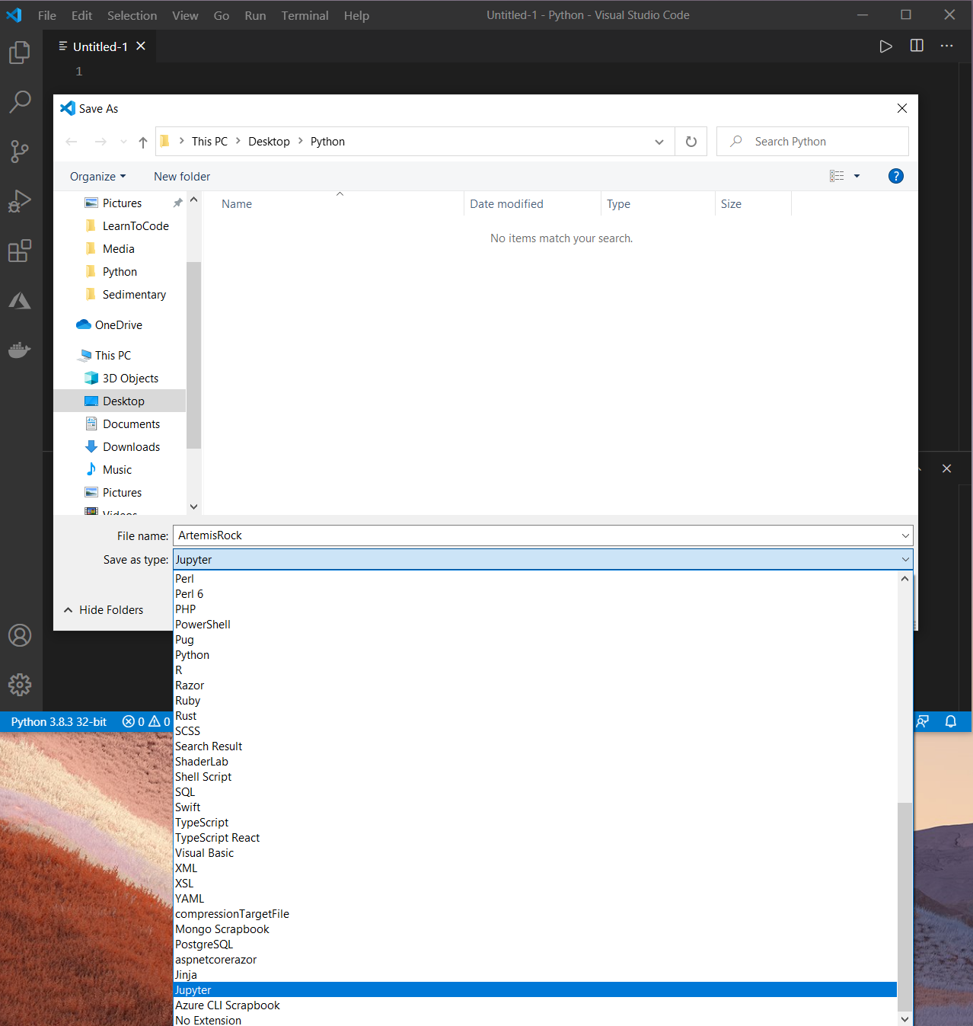
Create a Jupyter Notebook file in Visual Studio Code and run a simple program

Slide 17
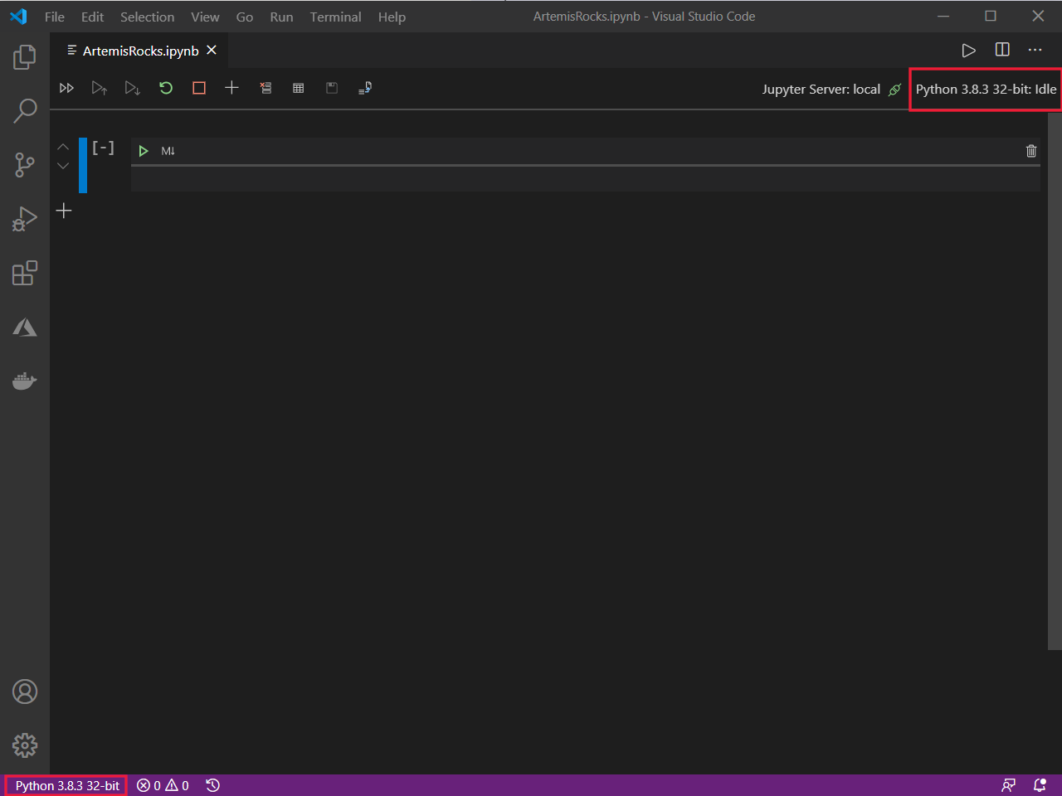
Configure Python environment

Slide 18
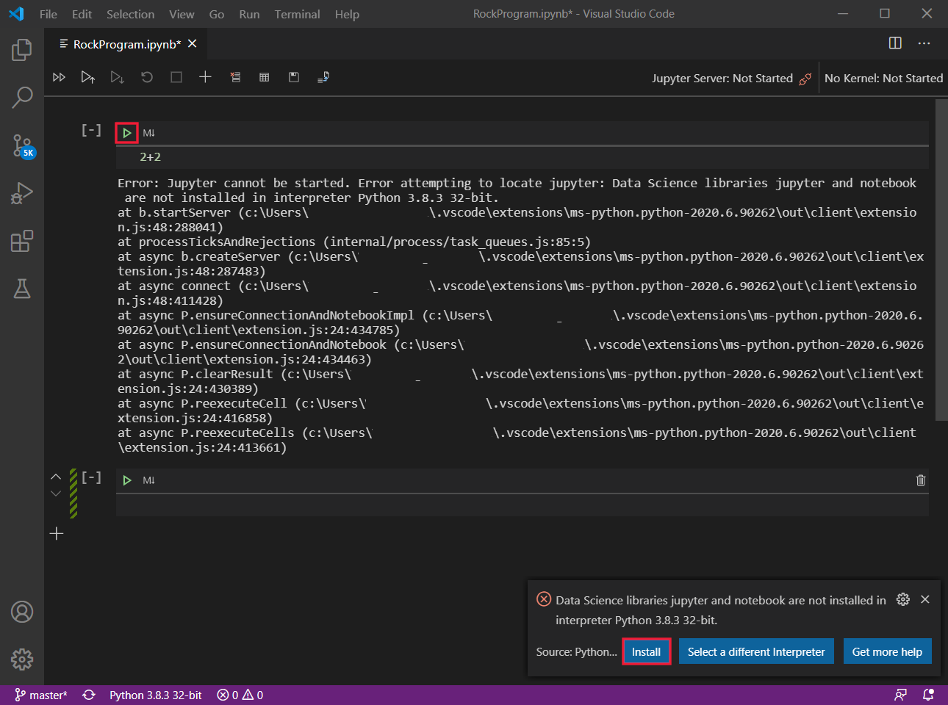
Configure Python environment

Slide 19
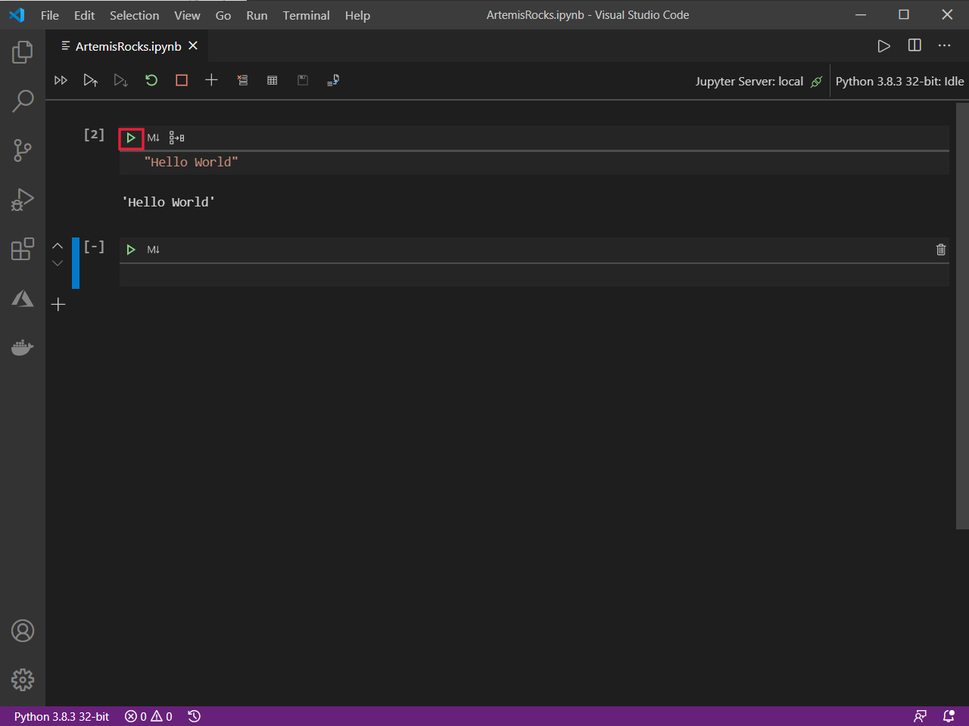
Write and run a simple program

Slide 20
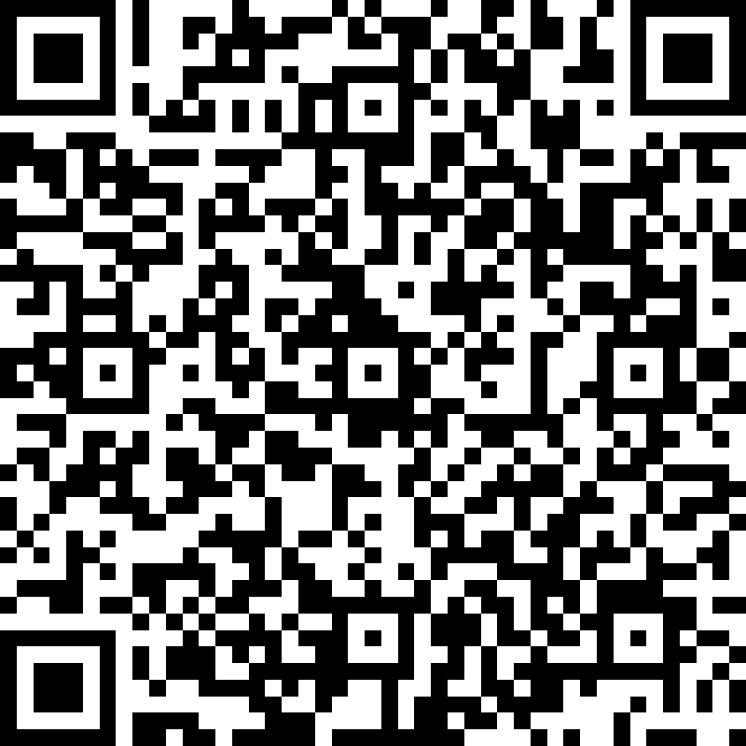
Quiz Time
https://forms.office.com/r/3yWvxssy8f

Slide 21
THANK YOU SO MUCH!!!

